Slide 2
Loan Application
Feb 8, 2024

Slide 3
Agenda
Objective
Problem Statement
Implementation
Logic
Input & output

Slide 4
Objective
The primary aim of this project is to create a console-based application and connect it with database for Loan Application Registration. It enables users to provide the input as first name, last name, fathers name and so on details for registration. This application then displays all the details which were entered by user and confirms that your registration successful.

Slide 5
Problem Statement
Designing of a simple console-based Node.js program and connect it with database for Loan Application. The program should allow users to provide the First Name, Last Name, Fathers Name, Company Name, Loan Amount, etc.

Slide 6
Implementation
Node.js
Read line module
Functions
Validations
Promises
MongoDB

Slide 7
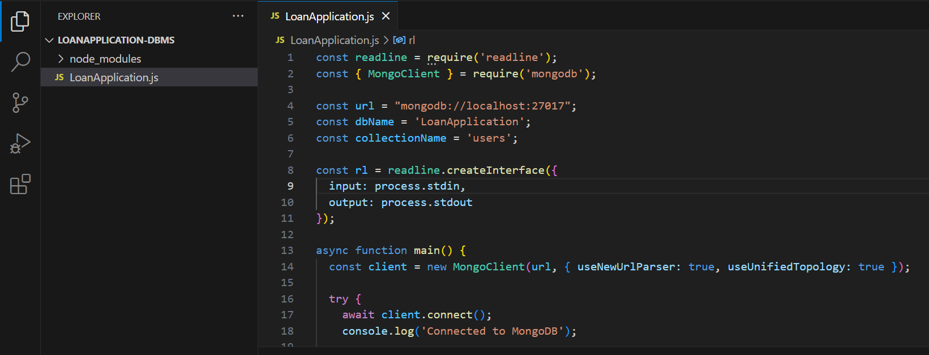
Logic
Connecting to MongoDB:

Slide 8
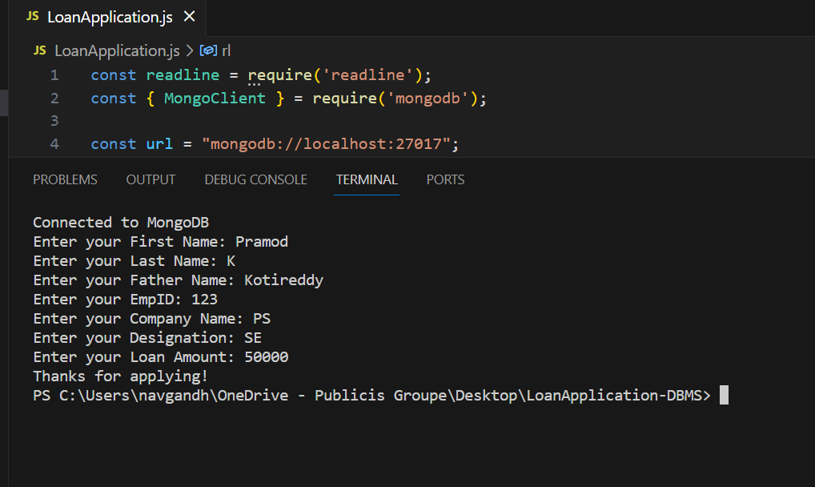
Logic
Output:

Slide 9
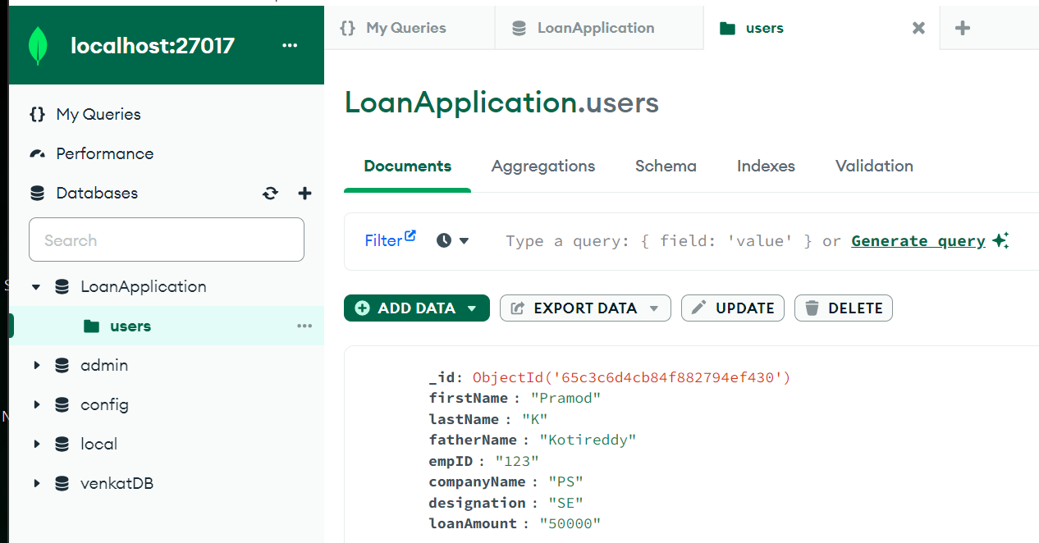
Output:

